Slide 1

CAP444 OBJECT ORIENTED PROGRAMMING USING C++

Slide 2
Topics Covered
Inheritance and type conversion :
inheritance:
importance,
types of inheritance,
type conversions:
importance,
basic to class type,
class to basic type,
one class to another class type

Slide 3



Inheritance: reusability
father
mother
child

Slide 4

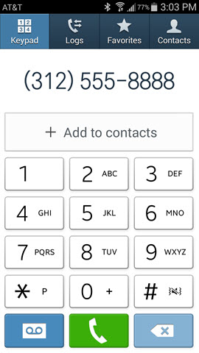
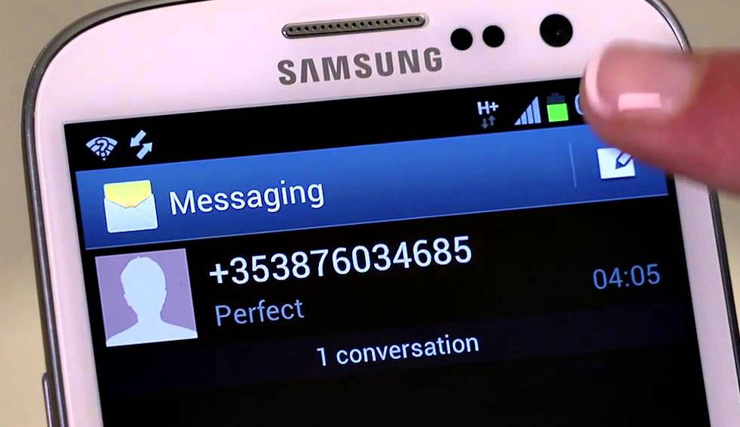
Contact List

Slide 5
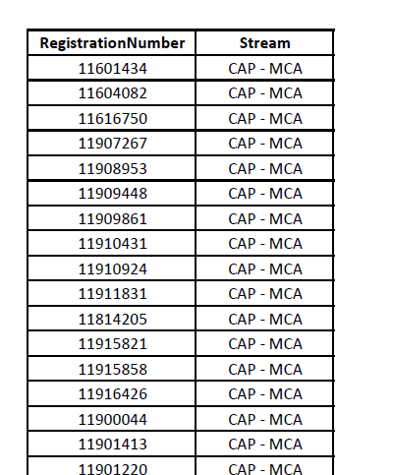
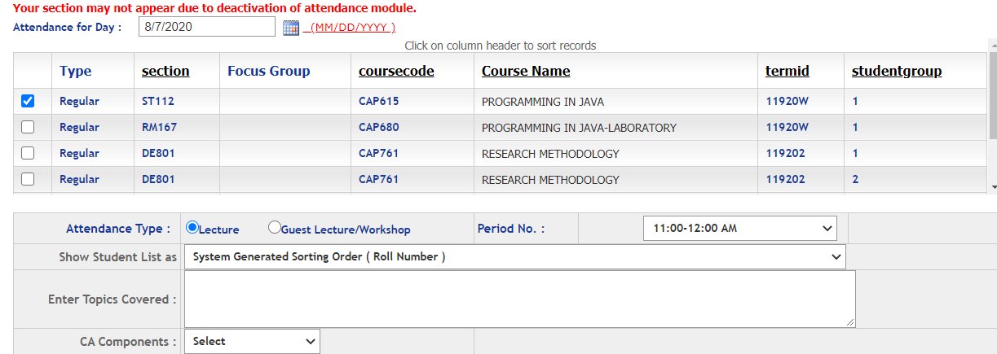
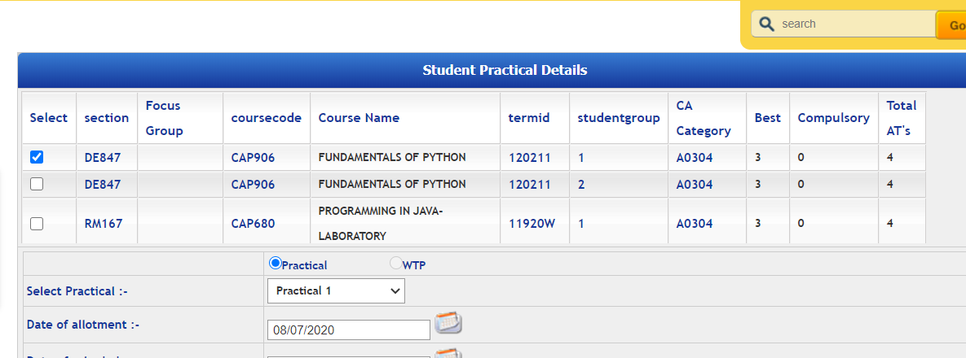
Students
Students in Attendance Module
Same Students in CA Module

Slide 6
Inheritance
One class can be derived from other class.
We can make the relationship between the classes.
We can re-use the functionality of classes
We can use different form of inheritance
Base Class
Derived Class

Slide 7
Inheritance: types of inheritance
A
A
A
B
B
B
C
C
Single
Multilevel
Multiple

Slide 8
A
A
B
C
B
C
Hierarchical Inheritance
D
Hybrid Inheritance

Slide 9
Single inheritance:
Syntax:
class derive_class_name : access_mode base_class_name
{
//body of derive_class
};

Slide 10
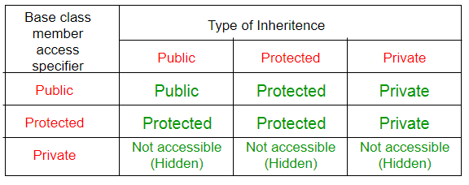
class base_class
{
//base class members (x, y)
};
class derive_class : access_Specifier base_class
{
//base class members (x, y)
//derive class members (a,b)
};

Slide 11

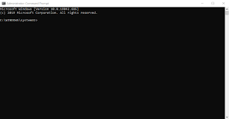
WindowColor
getColor()
ConsoleBackground
setName()

Slide 12
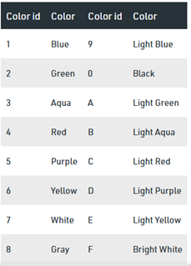
system("Color XY")
background color change the value X
text color change the value Y

Slide 13


Single inheritance Example
Result
ExamType
ExamStatus
getResult()
Student
Regno,
Name,
Marks
getStudentDetails()

Slide 14
Multilevel inheritance:
One class is going to become base class for other derived class
PMFund
FundAmount=1000
Base Class for class Bank
Bank
BankName=“SBI” IFSCCode=“SBI001”
Derived Class from PMFund and
Base Class for Customer
Customer
Cust_Name, Cust_Id, BalanceAmount
checkBalance():
Derived Class from Bank

Slide 15





Hierarchical inheritance:
One base class and multiple derived class, one –to-many relationship

Slide 16
Multiple Inheritance
class Derived: public Base1, public Base2, ......
class Base1:
class Base2:
.
.
.
class BaseN:
A
B
C

Slide 17



student

Slide 18
Ambiguity in Inheritance
In multiple inheritances, when one class is derived from two or more base classes then there may be a possibility that the base classes have functions with the same name.
getUniversityDetails()
getUniversityDetails()
?

Slide 19

We can solve using scope resolution operator
Syntax:
ObjectName.ClassName::FunctionName();
Example:
https://github.com/vishalamc/cap444/blob/main/ambiguityInhritanceExample

Slide 20
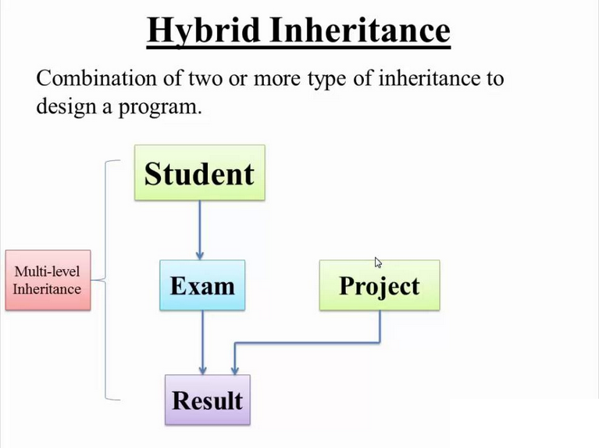

Slide 21
#include <iostream>
using namespace std;
class MyBaseClass {
public:
MyBaseClass(int x) {
cout << "Constructor of base class: " << x << endl;
}
};
class MyDerivedClass : public MyBaseClass {
public:
MyDerivedClass(int y) : MyBaseClass(50) {
cout << "Constructor of derived class: " << y << endl;
}
};
int main() {
MyDerivedClass derived(100);
}
Output:
Constructor of base class: 50
Constructor of derived class: 100
To call base class constructor in derived class

Slide 22
Examples
Single Inheritance:
https://github.com/vishalamc/cap444/blob/main/singleInheitanceExample
Multilevel Inheritance:
https://github.com/vishalamc/cap444/blob/main/multiLevelInheritanceExample
Hierarchical Inheritance:
https://github.com/vishalamc/cap444/blob/main/hierachicalInheritanceExample
Multiple Inheritance:
https://github.com/vishalamc/cap444/blob/main/multipleInheritanceExample
Hybrid Inheritance:
https://github.com/vishalamc/cap444/blob/main/hybridInheritanceExample

Slide 23


Type Conversion

Slide 24
Type Conversion
Basic data types conversion done automatic by compiler
User define data type conversion not done automatically
User define data type conversion done by using either constructor or by using casting operator

Slide 25
What will be output?
#include <iostream>
using namespace std;
int main()
{
double a = 21.09399;
float b = 10.20f;
int c ;
c = a;
cout << c ;
c = b;
cout << c ;
return 0;
}
2110
1210
21
121

Slide 26
Three type of situation occurs during user define type conversion:
1. basic type to class type(using constructor)
2. class type to basic type(using casting operator function)
3. class type to class type (using constructor and casting operator function both)

Slide 27
basic type to class type(using constructor)
#include <iostream>
using namespace std;
class A
{
};
int main()
{
A a1;
int x=8;
a1=x ;//basic to class type
return 0;
}
Example:
https://github.com/vishalamc/cap444/blob/main/basicToClassTypeExample
Basic type to class type achieved by using constructor.

Slide 28
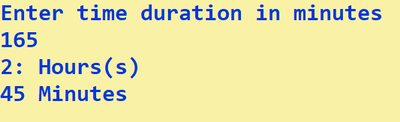
Time
hours, mins
display()

Slide 29
class type to basic type(using casting operator function)
Class type to basic type done by using casting operator function
It must be a define inside in class.
It must not specify a return type in function signature.
It must not have any arguments.
class A
{};
A a1;
int x;
x=a1 //class type to basic type
Example:
https://github.com/vishalamc/cap444/blob/main/classToBasicTypeUsingCastingOperator

Slide 30
casting operator function
Syntax:
operator dest_typename()
{
return statement;
}
operator int()
{
return a;
}

Slide 31
Class type to class type (using constructor and casting operator function both)
Ex: A obj1; B obj2;
obj1 = obj2 ; // obj1 and obj2 are objects of different classes
First approach using Constructor:-
Left side of assignment operator(=) which is class object we have to create constructor in that class here in Class A.
Example:
https://github.com/vishalamc/cap444/blob/main/ClassToClassTypeUsingConstructor
Second approach using casting operator function:
Right side of assignment operator(=) which is class object we have to create casting operator function in that class here class B.
Example:
https://github.com/vishalamc/cap444/blob/main/ClassToClassTypeUsingCastingOperator

Slide 32
What will be out put for the following code?
#include <iostream>
using namespace std;
class Circle
{
int radius;
Circle(){}
Circle(int radius)
{
this->radius=radius;
cout<<this->radius;
}
};
int main()
{
Circle a1, b1(5);
Circle b2 = Circle(8);
return 0;
}
55
88
58
Error

Slide 33
What will be out put for the following code?
#include <iostream>
using namespace std;
class Circle
{
int radius;
public:
Circle(){}
Circle(int radius)
{
this->radius=radius;
cout<<this->radius;
}
};
int main()
{
Circle a1, b1(5);
Circle b2 = Circle(8);
return 0;
}
55
88
58
Error

Slide 34
Any Query?

